Slide 1


Slide 2


Slide 3
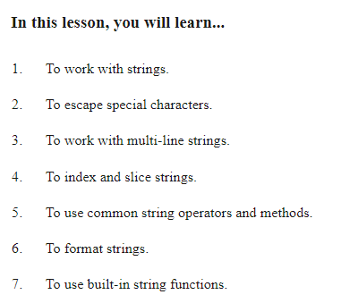
Python Strings

Slide 4
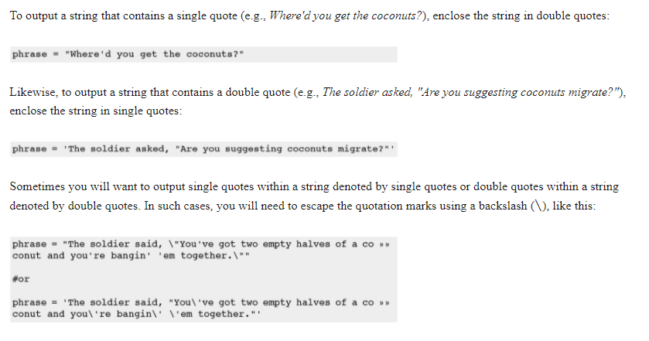
Escaping Characters

Slide 5
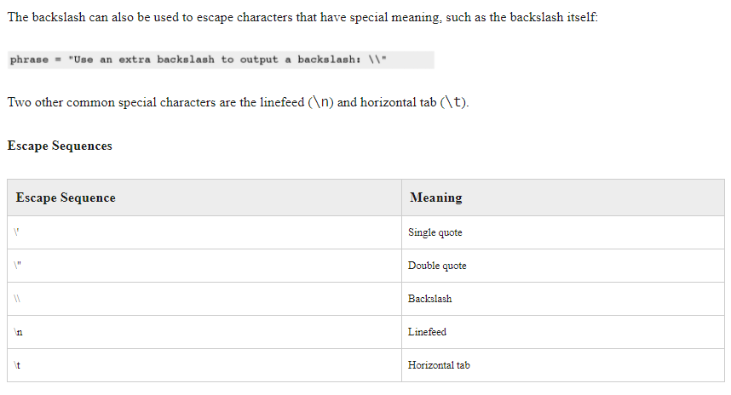
Special Characters

Slide 6
Oefening
Hij zei: “Dit is een lastige tekst om te printen”
Piet zei: “Peter’s Tas ligt nog thuis”.
C:\test\new.txt
Print deze zinnen

Slide 7
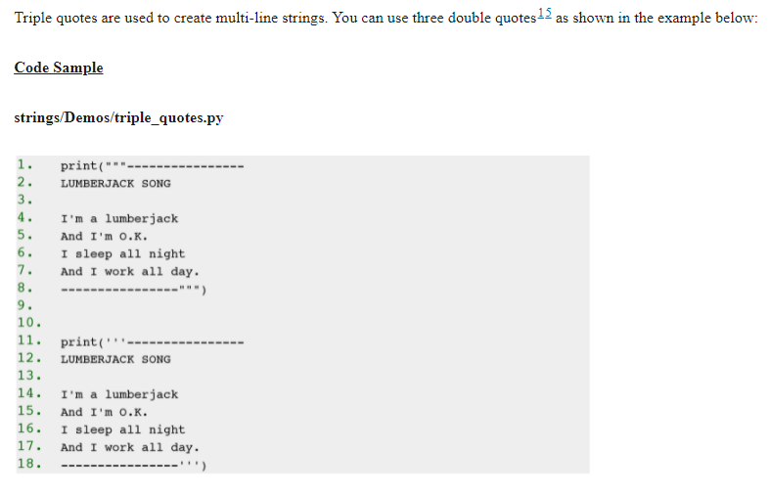
Triple Quote

Slide 8
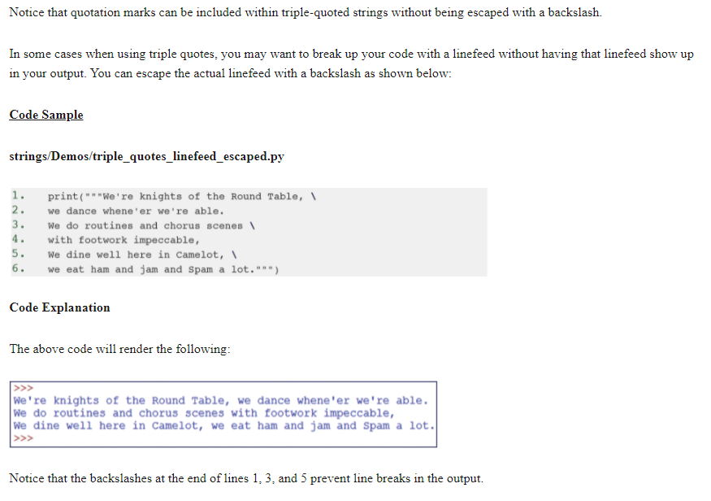

Slide 9
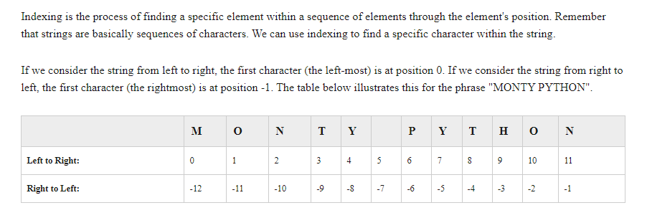
String Indexing

Slide 10
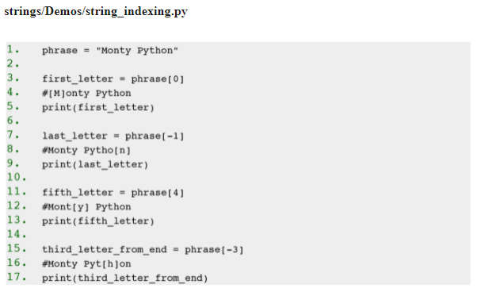

Slide 11
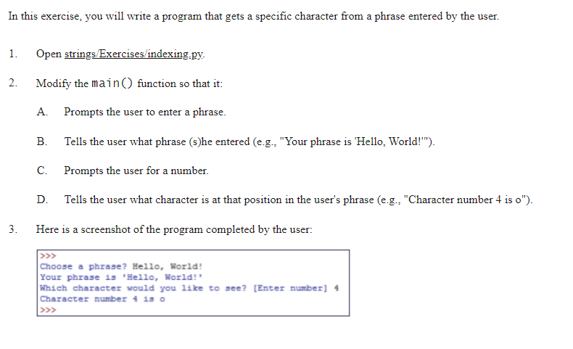
Exercise 9 Indexing Strings
Notes:
Hier zijn we gebleven!

Slide 12
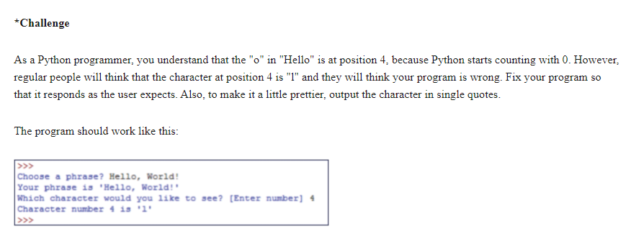

Slide 13
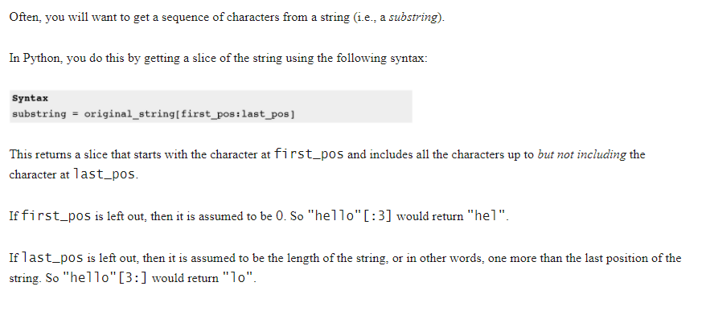
Slicing Strings

Slide 14
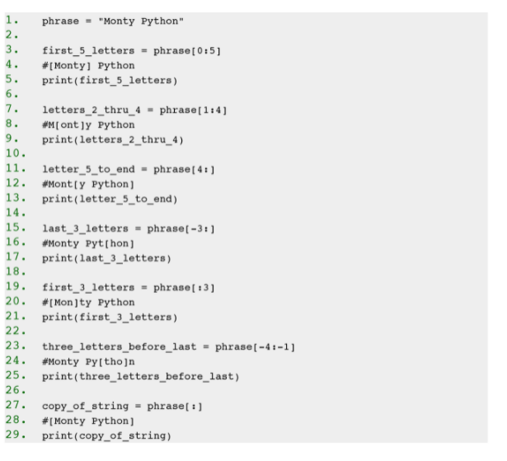

Slide 15
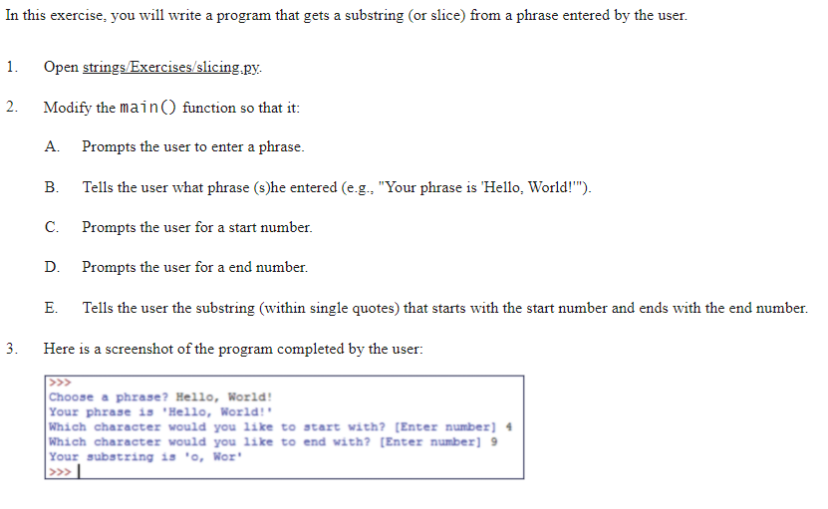
Exercise 10 Slicing Strings

Slide 16
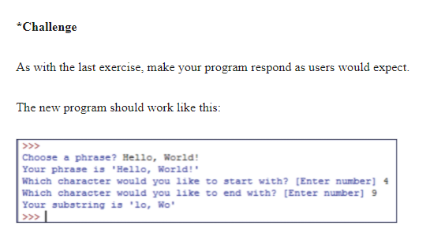

Slide 17
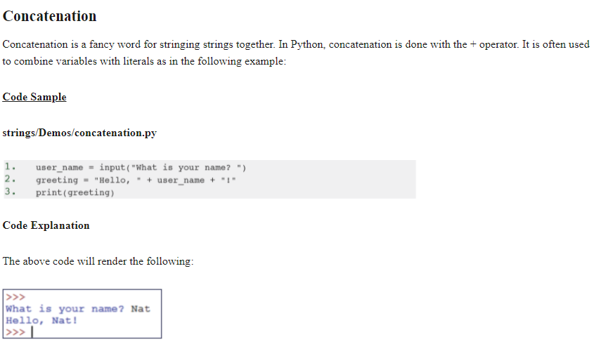
Concatenation

Slide 18
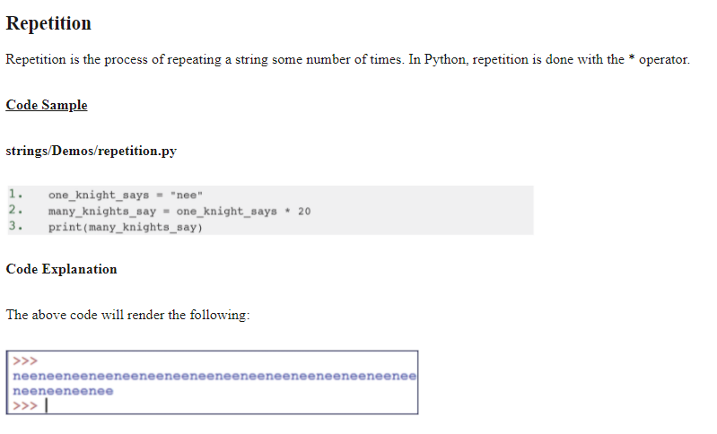
Repetition

Slide 19
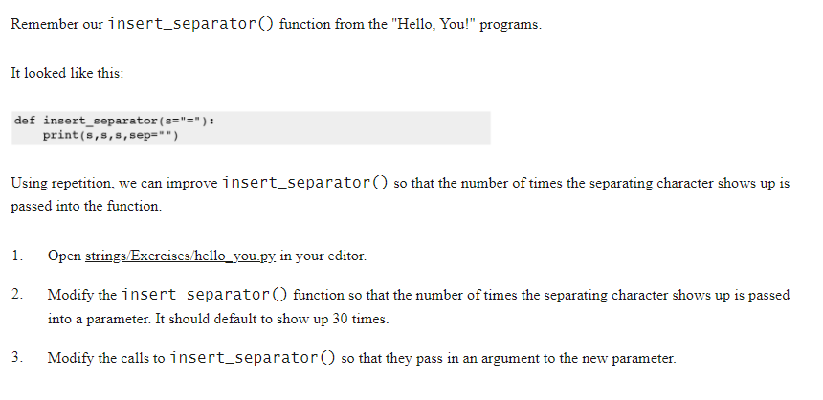
Exercise 11 Repetition

Slide 20
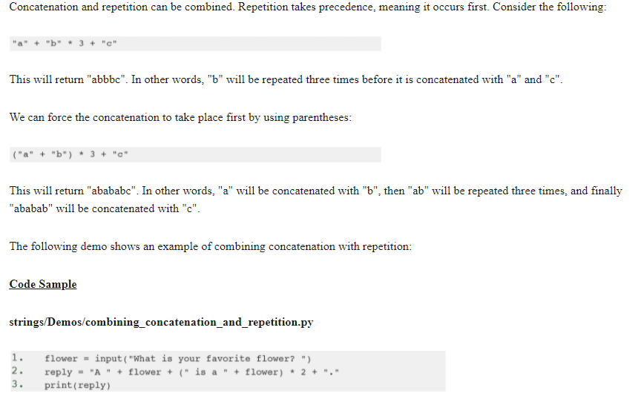
Combining Concat and Repeat

Slide 21
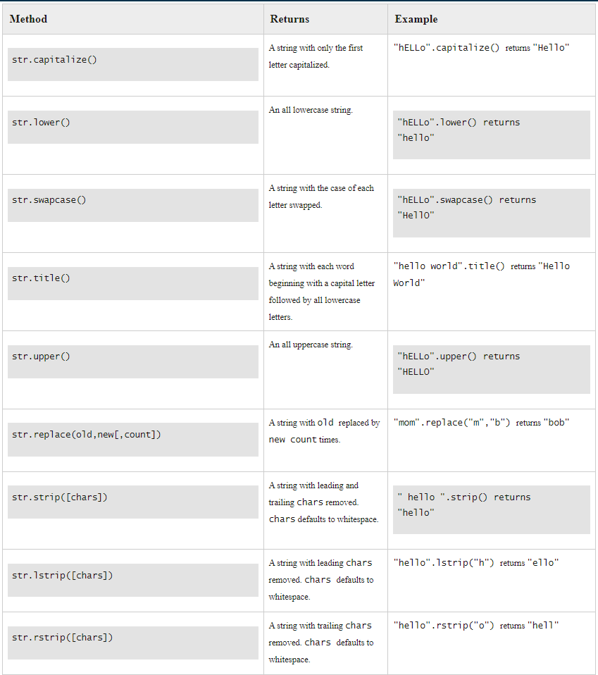
String Methods

Slide 22
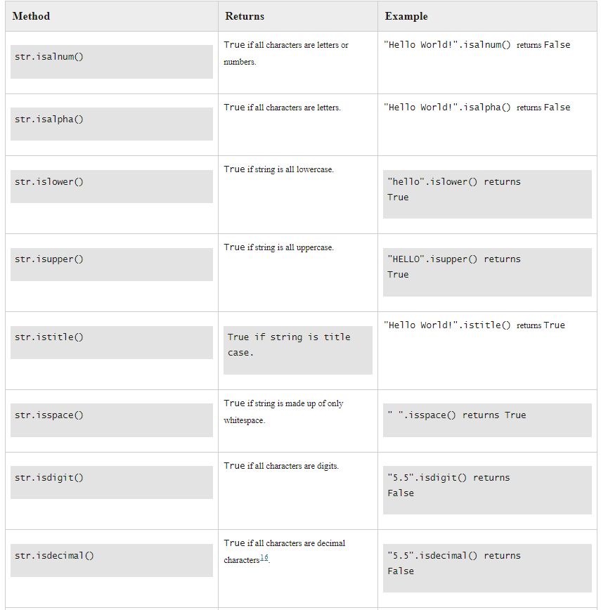
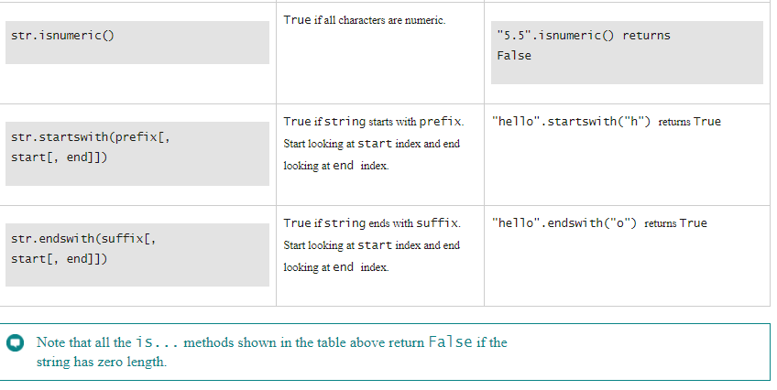

Slide 23
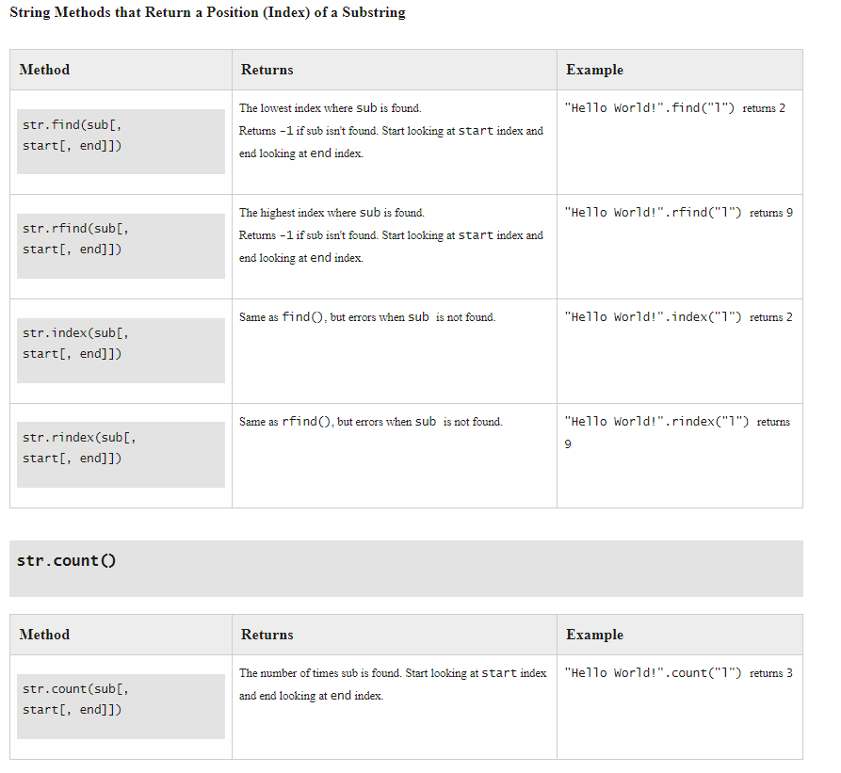

Slide 24
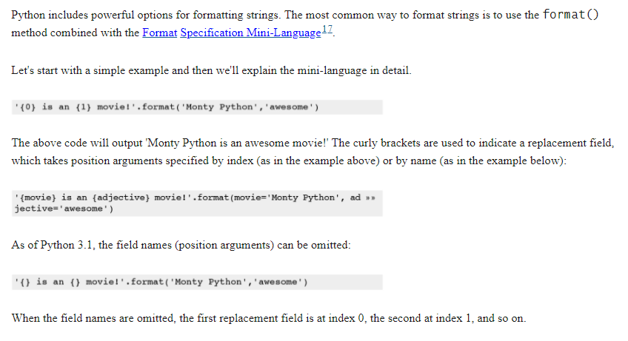
String Formatting

Slide 25
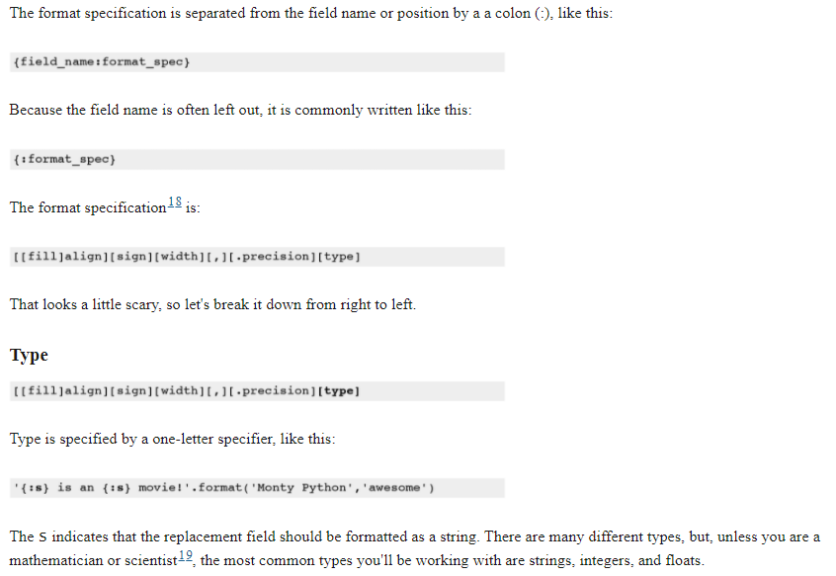
Format Specification

Slide 26
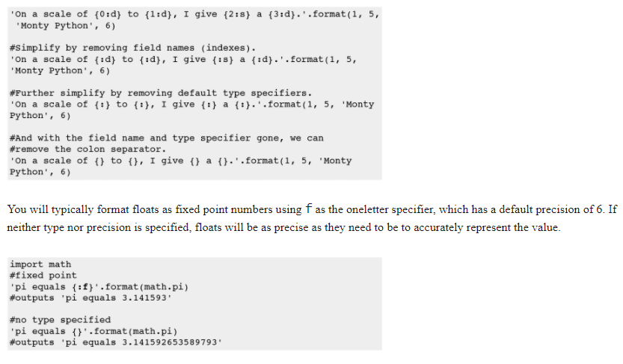

Slide 27
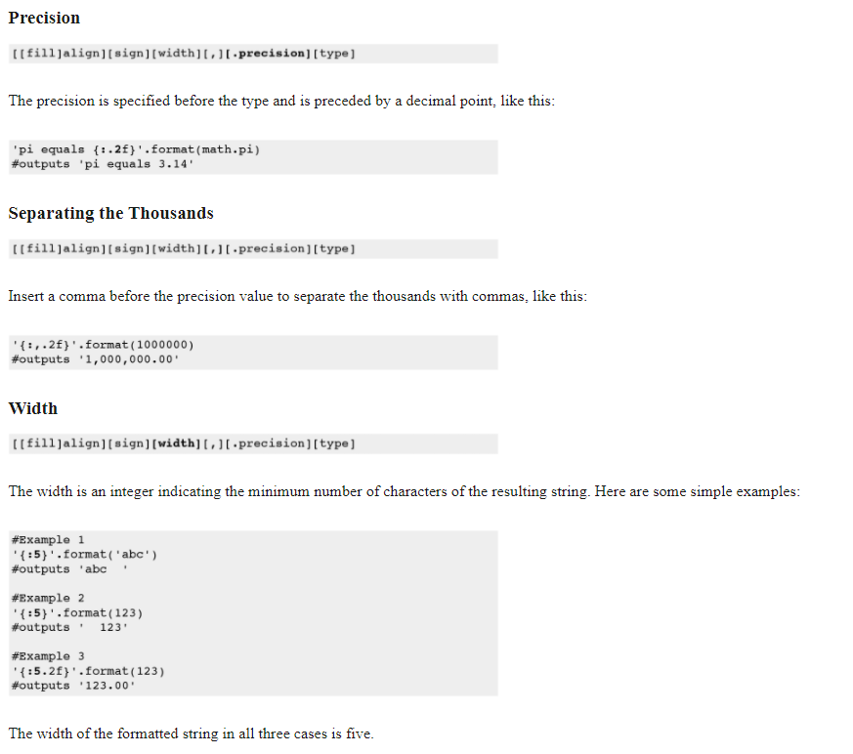

Slide 28
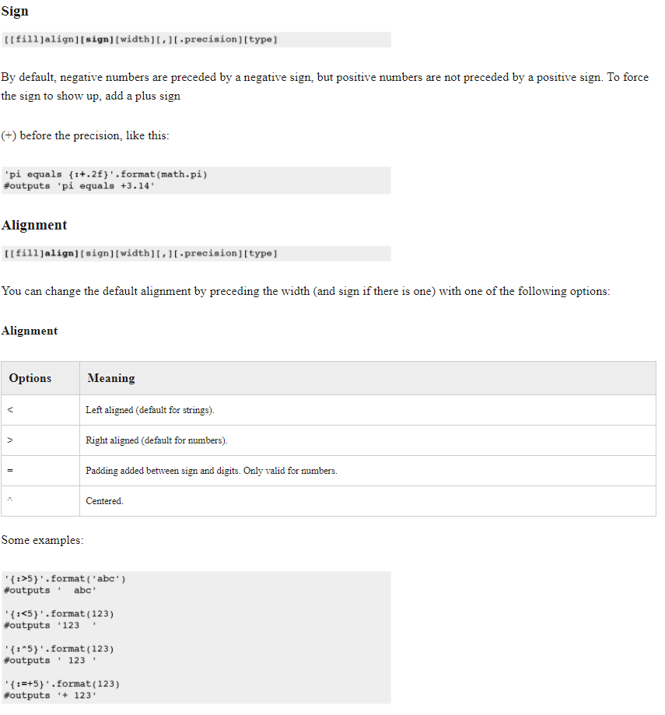

Slide 29
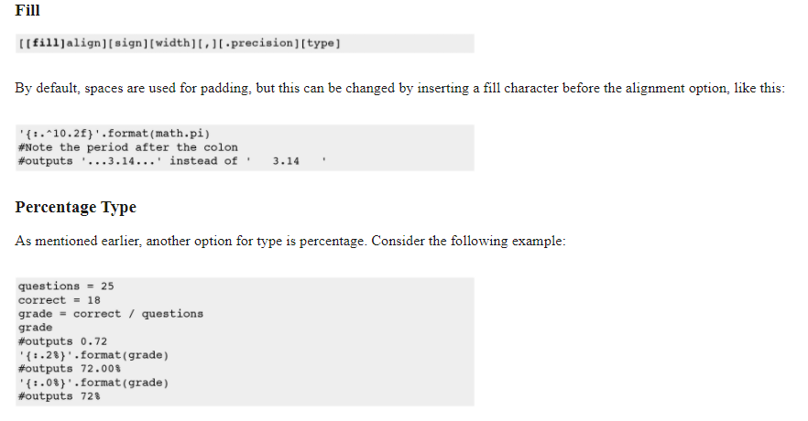

Slide 30
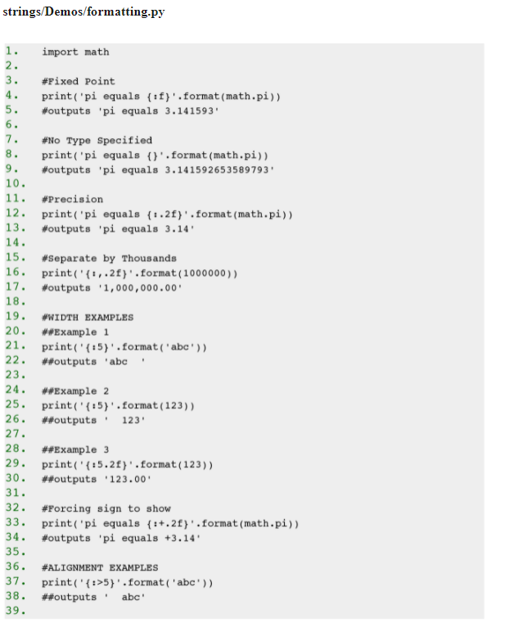
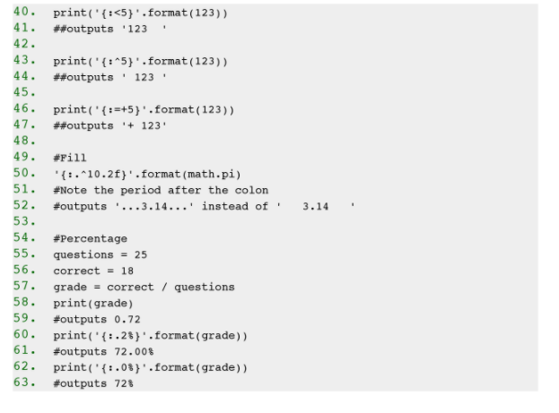

Slide 31
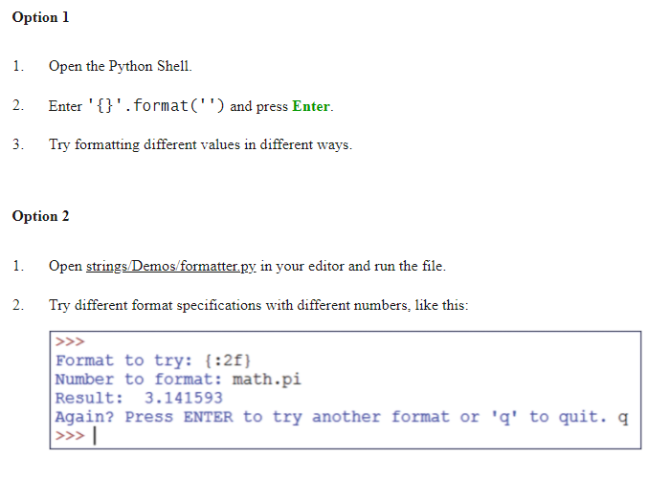
Exercise 12 Playing with Formattin

Slide 32
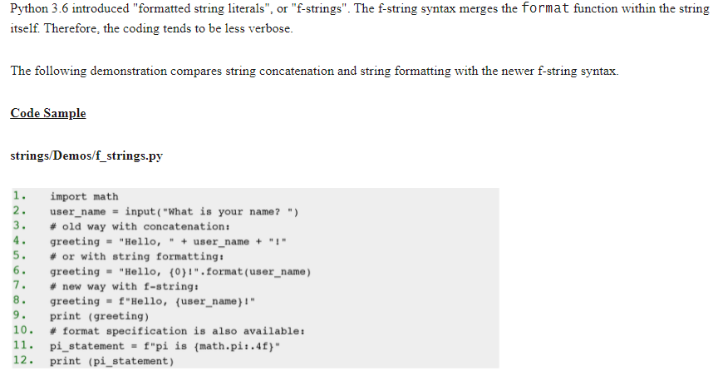
Formatting String Literals f-strings

Slide 33
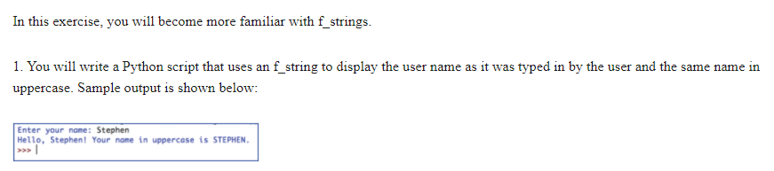
Exercise 13 f-strings

Slide 34
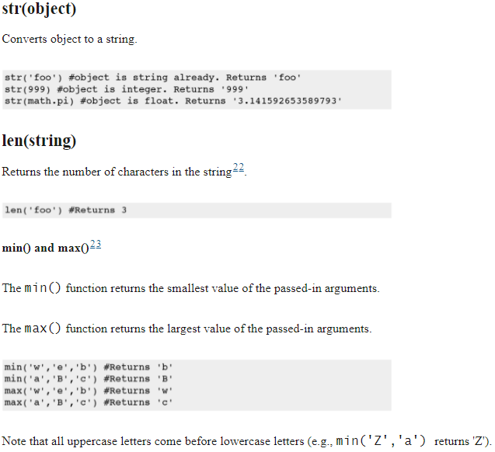
Build-in String Functions

Slide 35
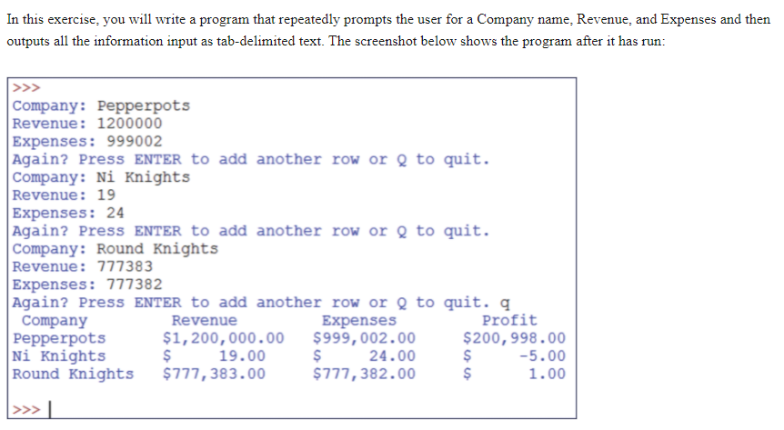
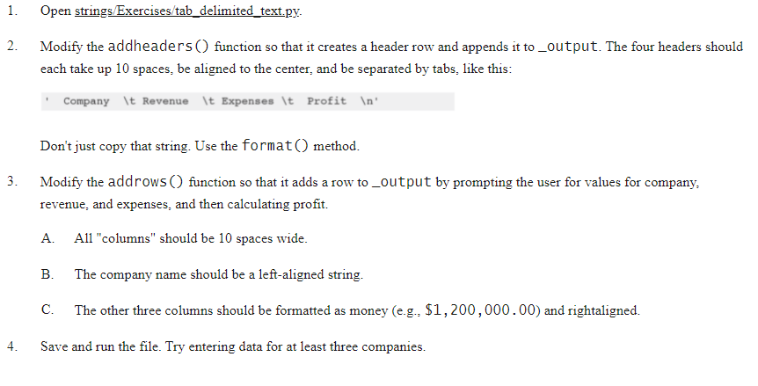
Exercise 14 Outputting Tab-delimited Text

Slide 36
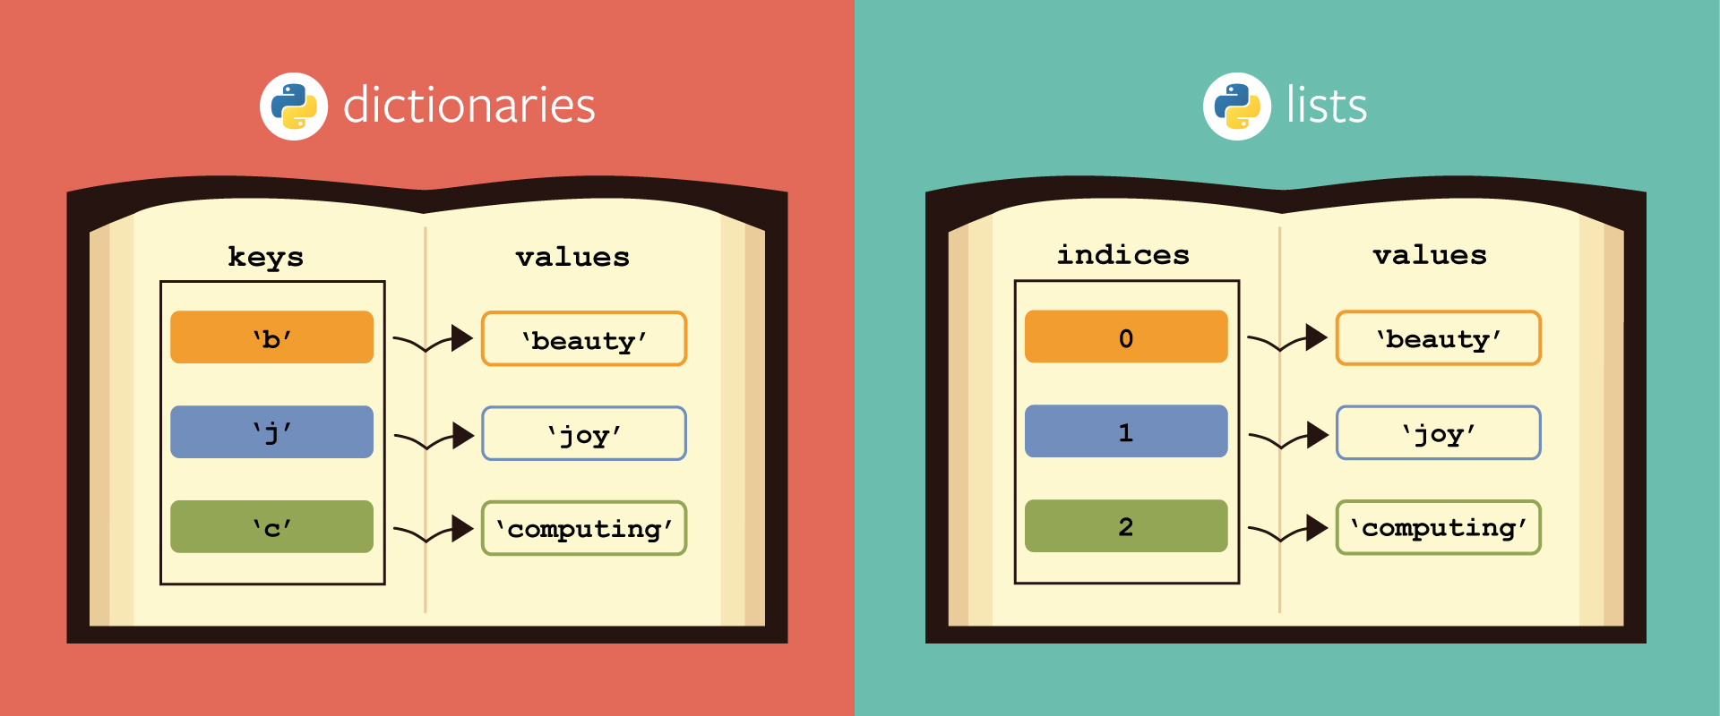

Slide 37
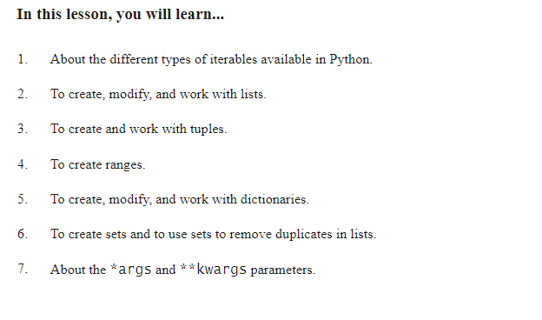
Iterables: Sequences, Dictionaries, and Set

Slide 38
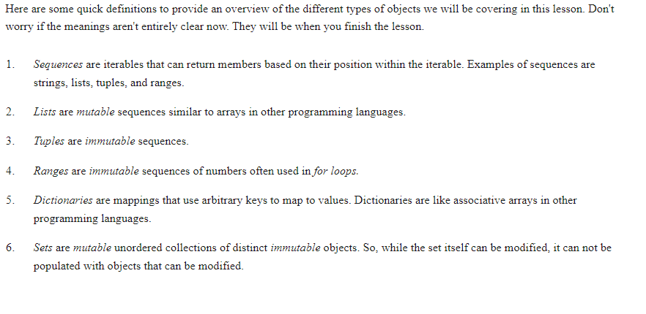
Definitions

Slide 39
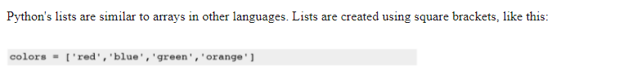
Lists

Slide 40
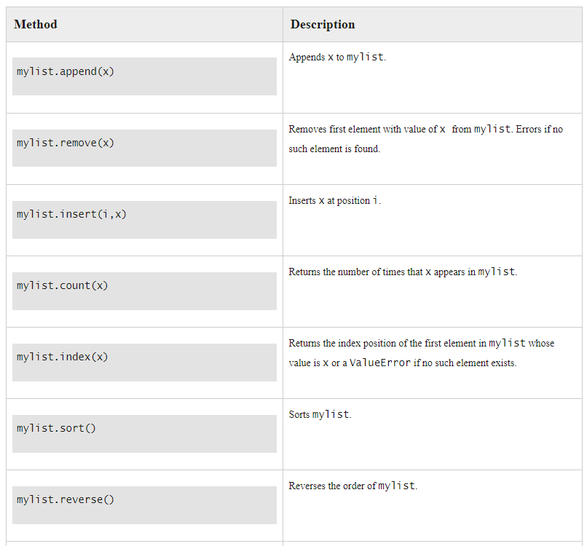

Slide 41
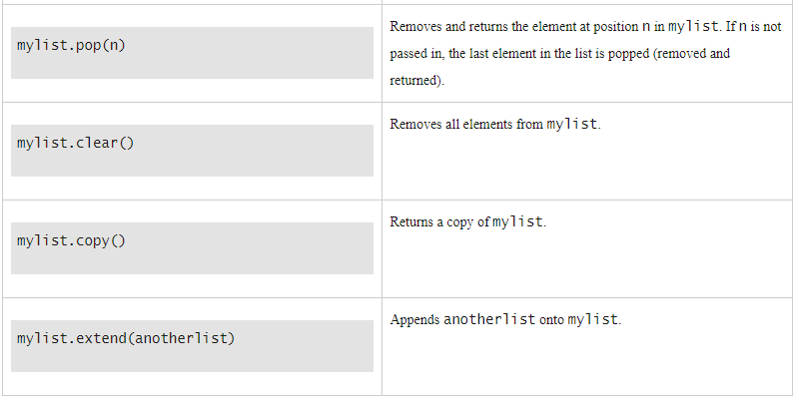

Slide 42
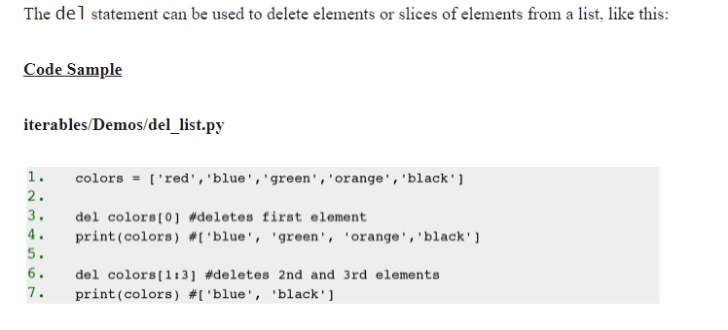
Deleting List Elements

Slide 43
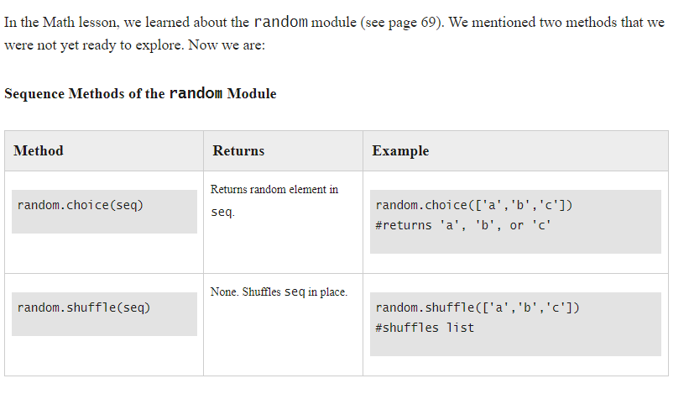
Sequences and Random

Slide 44
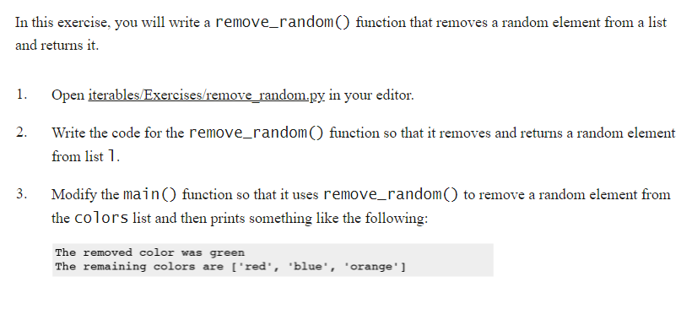
Exercise 15 Remove and Return Random

Slide 45
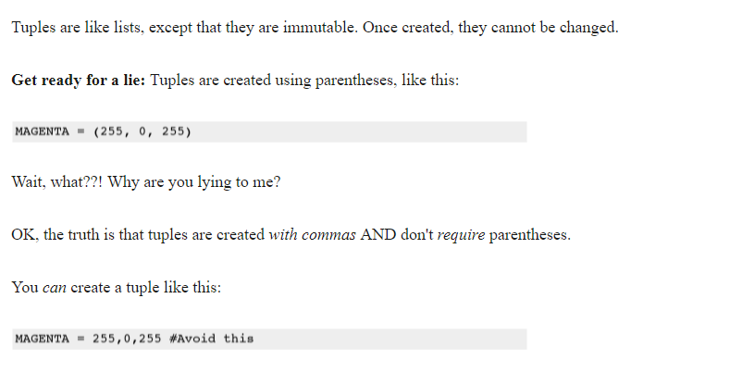
Tuples

Slide 46
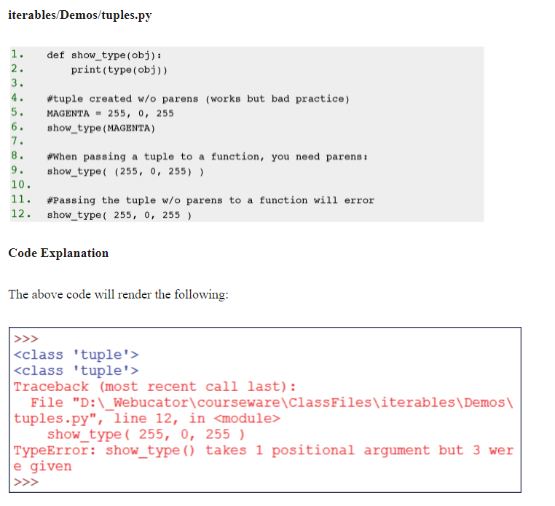

Slide 47
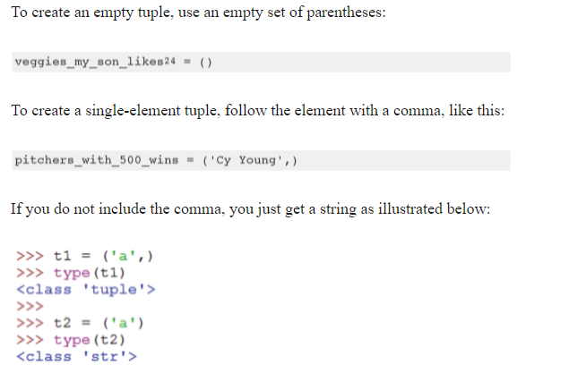
Single Element Tuple

Slide 48
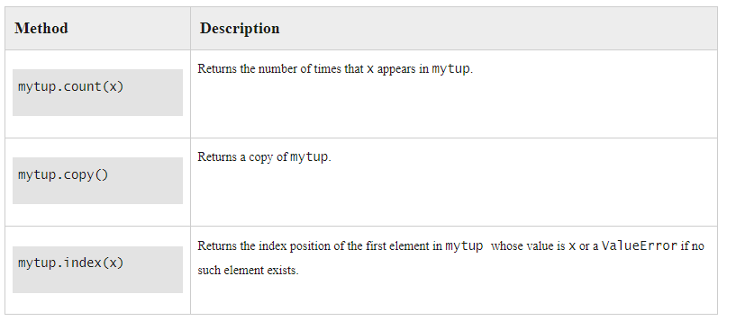
Common Tuple Methods

Slide 49
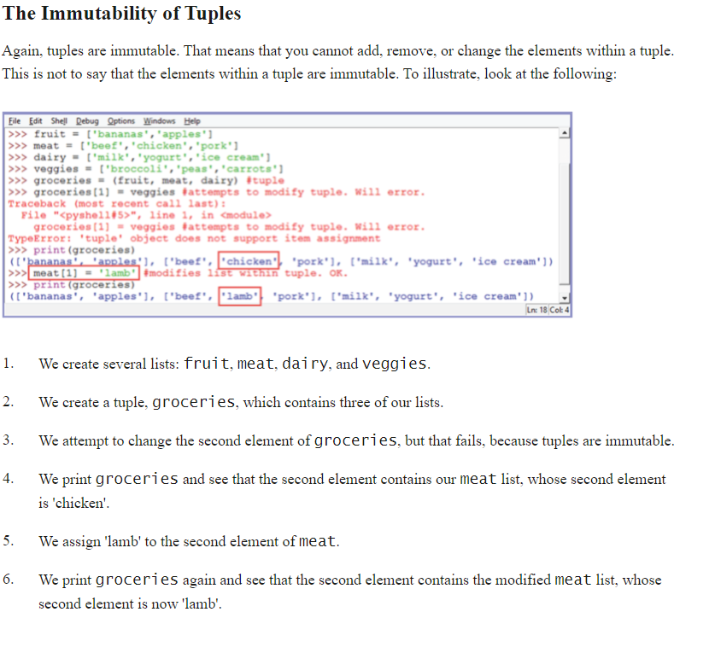

Slide 50
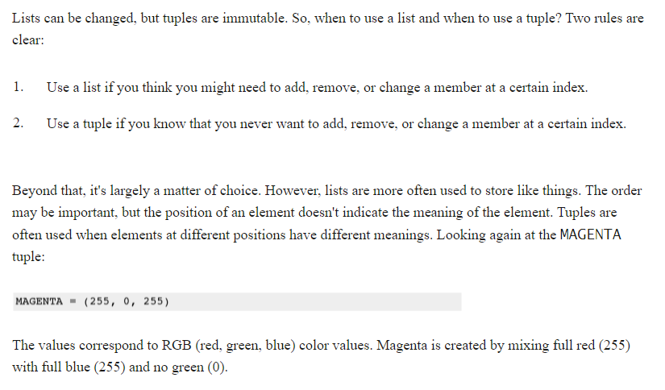
Lists vs Tuples

Slide 51

Ranges

Slide 52


Slide 53

Converting Sequences to Lists

Slide 54

Indexing and Slicing

Slide 55


Exercise 16 Simple Rock, Paper, Scissors Game

Slide 56

Slicing

Slide 57


Slide 58


Exercise 17 Slicing Sequences

Slide 59

min(iter) and max(iter)

Slide 60

sum(iter)

Slide 61

Converting Sequences to Strings

Slide 62


Slide 63

splitlines() method

Slide 64

Unpacking Sequences

Slide 65

Dictionaries

Slide 66

Dictionary methods

Slide 67

The update() method

Slide 68


The setdefault() method

Slide 69

Dictionary View Objects

Slide 70


Slide 71


Slide 72

Deleting Dictionary Keys

Slide 73

The len() Function

Slide 74


Exercise 18 Creating a Dictionary

Slide 75


Sets

Slide 76

*args and **kwargs

Slide 77

Order of Parameters

Slide 78

Using *args

Slide 79

Flow Control

Slide 80

Flow Control

Slide 81

Conditional Statements

Slide 82


Slide 83


Slide 84

Membership Operators

Slide 85

Example

Slide 86

Compound Conditions

Slide 87


Slide 88



The is and is not Operators

Slide 89

__name__

Slide 90



all() and any()

Slide 91

Ternary Operator

Slide 92

while Loops

Slide 93


Slide 94


Slide 95

For Loops

Slide 96


Slide 97


Slide 98


Slide 99


Exercise 19 All True and Any True

Slide 100

break and continue

Slide 101


Exercise: A bit of a Puzzle
Make Loops to print the following figures
You can print them on separate lines, it is not needed to print them one after the other on the same line
Ask the user for the dimensions. In this case 6 x 6, but any value should be possible

Slide 102
Exercise 20 Word Guessing Game

Slide 103



The else Clause

Slide 104

Exercise 21 Find the Needle

Slide 105


Slide 106

The enumerate() Function

Slide 107


Slide 108


Generators

Slide 109


Slide 110


Slide 111

Generator Use Case: Random Moving

Slide 112

The next() Function

Slide 113


Slide 114

Exercise 22 Rolling Dice

